Slide 1

KSU Athletics Data Warehouse
AJ Johnson

Slide 2
Identifying Our Goals
Enhance Student Participation in KSU Athletic Events
Maximize Ticket Revenue Streams
Establish the Foundation for Future KSU Software Initiatives
Foster a Data-Driven Organizational Culture

Slide 3
Business Opportunity
Comprehensive Solution: Offer a one-stop tool for identifying various fan categories.
Efficiency & Automation: Streamline the identification process, saving staff time.
Data Hub: Serve as a stepping stone to a future data warehouse for KSU.
Customizability: In-house development ensures flexibility for department-specific needs.

Slide 4
Business Objectives
Increase Revenue: Systematically identify and target potential ticket purchasers.
Cost Savings: Reduce operational expenses by automating the identification process.
Boost Attendance: Meet and exceed attendance goals as KSU transitions into C-USA.
Insight into Trends: Offer rapid analysis of fan behavior and preferences.

Slide 5


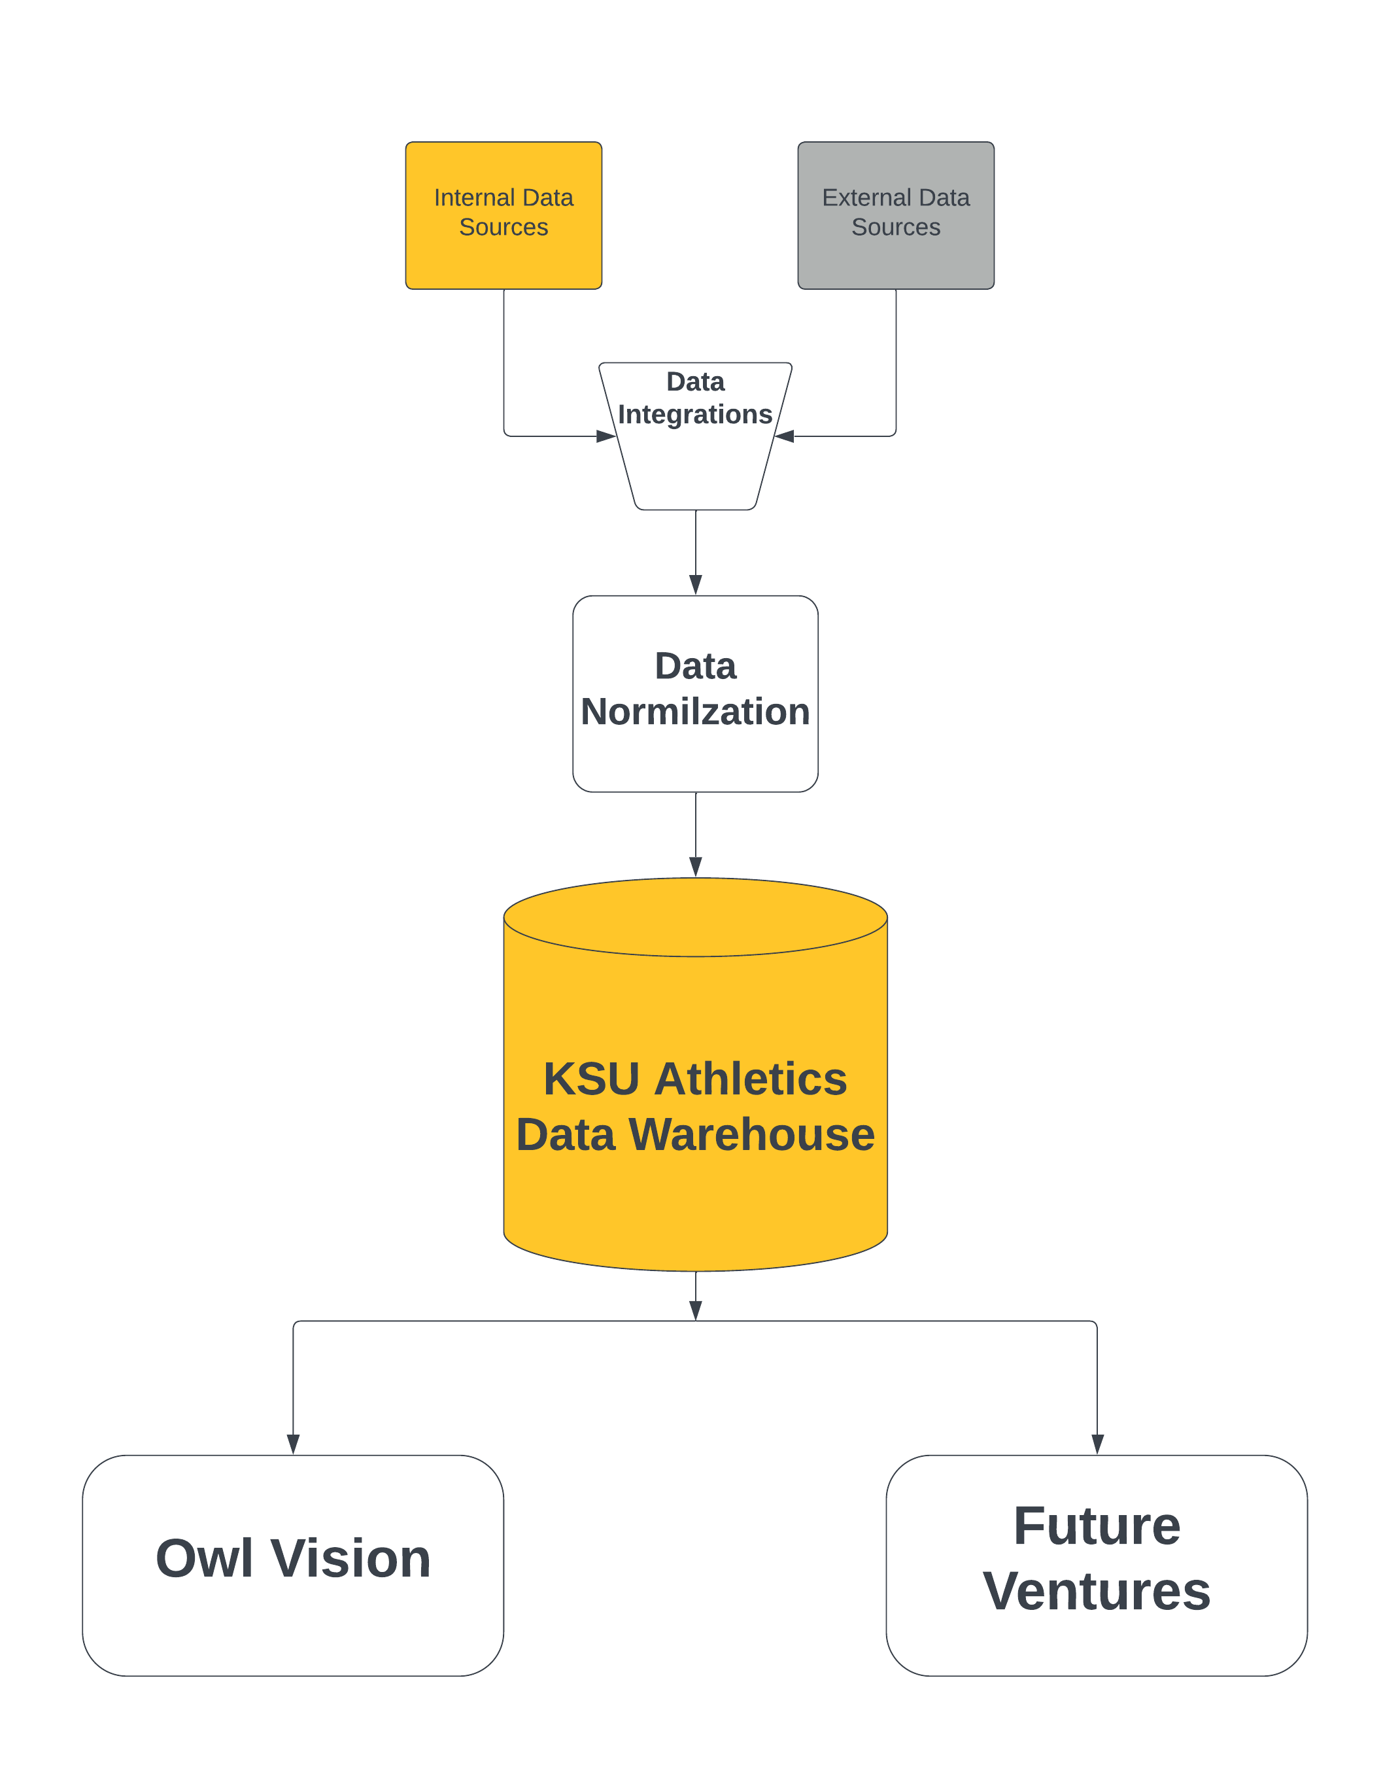
Data Pipeline
Data Sources
Data Normalization
Data Warehouse

Slide 6
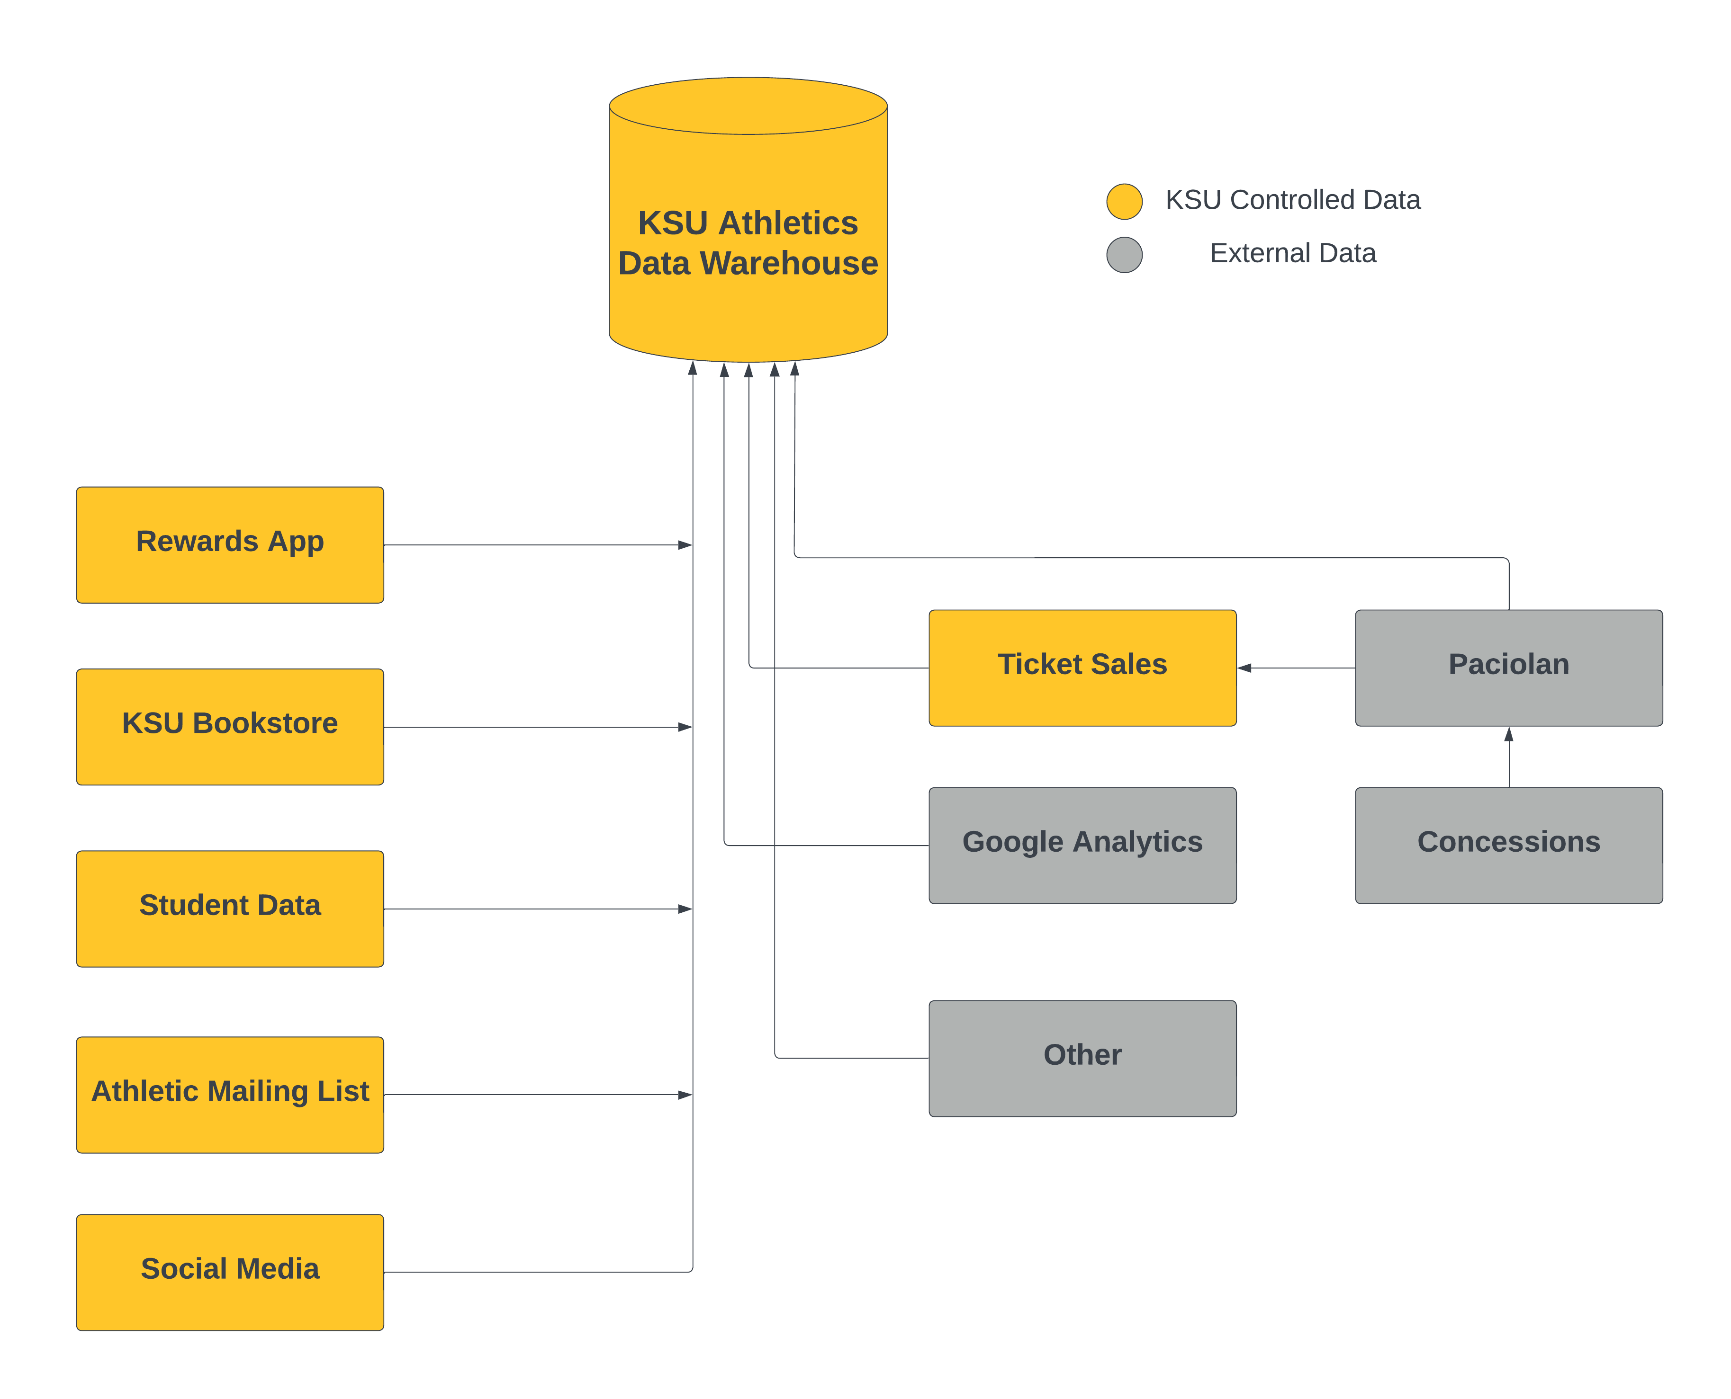
Data Sources
Internal Sources
External Sources
Architect to Expand

Slide 7
How do we accomplish this?
Trend Identification: Recognize initial patterns from persistent data sources for actionable insights.
Infrastructure Development: Construct a sustainable architecture and processes designed for long-term utility and modularity.
User-Centric Design: Develop an intuitive interface that caters to the needs of business users, ensuring smooth integration into existing workflows.
Continuous Improvement: Regularly review and adapt based on feedback, ensuring our system remains relevant and efficient.

